Slide 1
For inhabitants and entrepreneurs
What is ?
Notes:
The aim of this material is to provide a brief insight into the possibilities available to inhabitants and entrepreneurs on the portal Latvija.lv, which are necessary for using the portal, and into the way of preparing for using e-services by means of an eID card and e-signature.

Slide 2
Contents
Introduction
What is Latvija.lv?
How can the Public Service Directory be useful?
What are the possibilities of Latvija.lv e-services?
How to use Latvija.lv?
How to use Latvija.lv?
Authentication
How to prepare for using Latvija.lv by means of an eID card and e-signature?
Useful information sources
Contact information
Notes:
By studying the table of contents, one can gain an insight into the information included in the material, which is grouped in three blocks:
introduction — general insight into the portal Latvija.lv;
possibilities for inhabitants — practical information on how to use Latvija.lv step by step, what is necessary and how to prepare for using Latvija.lv by means of an eID card and e-signature;
information — frequently asked questions, additional information sources and contact information.

Slide 3
What is atvija.lv ?
Notes:
Before we discuss practical recommendations on how to use the portal, let us first observe the portal itself.

Slide 4
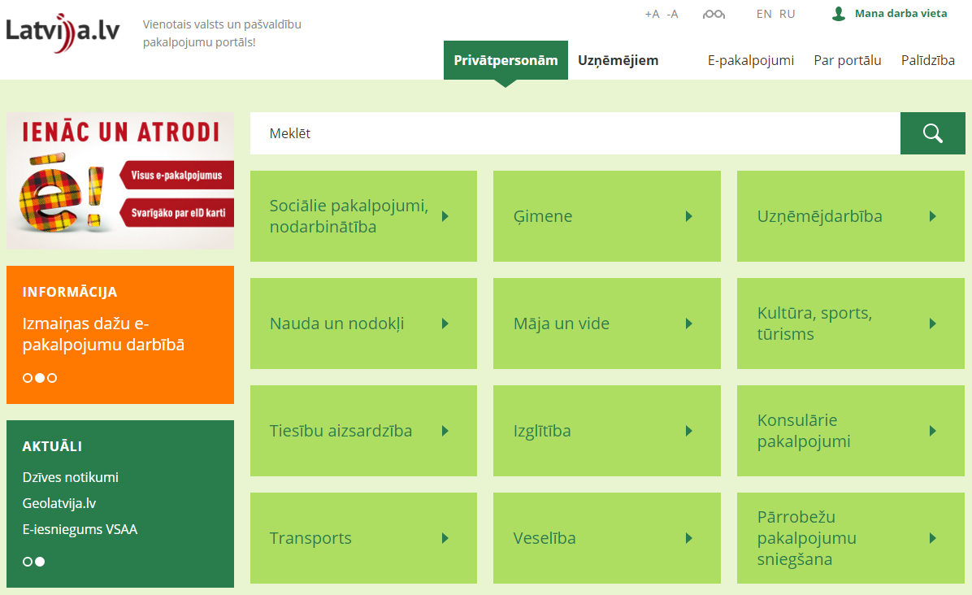
– portal of services provided by the state and local government
Notes:
Latvija.lv is the only site on the Internet, where all state services and e-services are gathered in a single place.

Slide 5
– Latvia’s central
site of services
Over 2,200
descriptions
of public services
Over 350
e-services
Notes:
Latvija.lv is a portal of state and local government services, where there are:
over 350 e-services provided by state and local government institutions, which are placed on the portal Latvija.lv;
Over 2,200 descriptions of public services provided by state and local government institutions.

Slide 6
What is available on the portal and where is it available?
Catalogue of e-services
Public Service
Directory
Notes:
This is the layout of catalogues on the homepage of the portal.
Moreover, in October 2015, Latvija.lv was improved for the site to become more convenient and clear (http://www.vraa.gov.lv/lv/news/article.php?id=41160 ).
E-service is an opportunity to receive services remotely via the Internet by using ICT means.
The Public Service Directory (PSD) is a register of public services provided by state administration and local government institutions, in which the descriptions of public services and the methods of their provision are available. It is publicly available on the portal Latvija.lv.

Slide 7
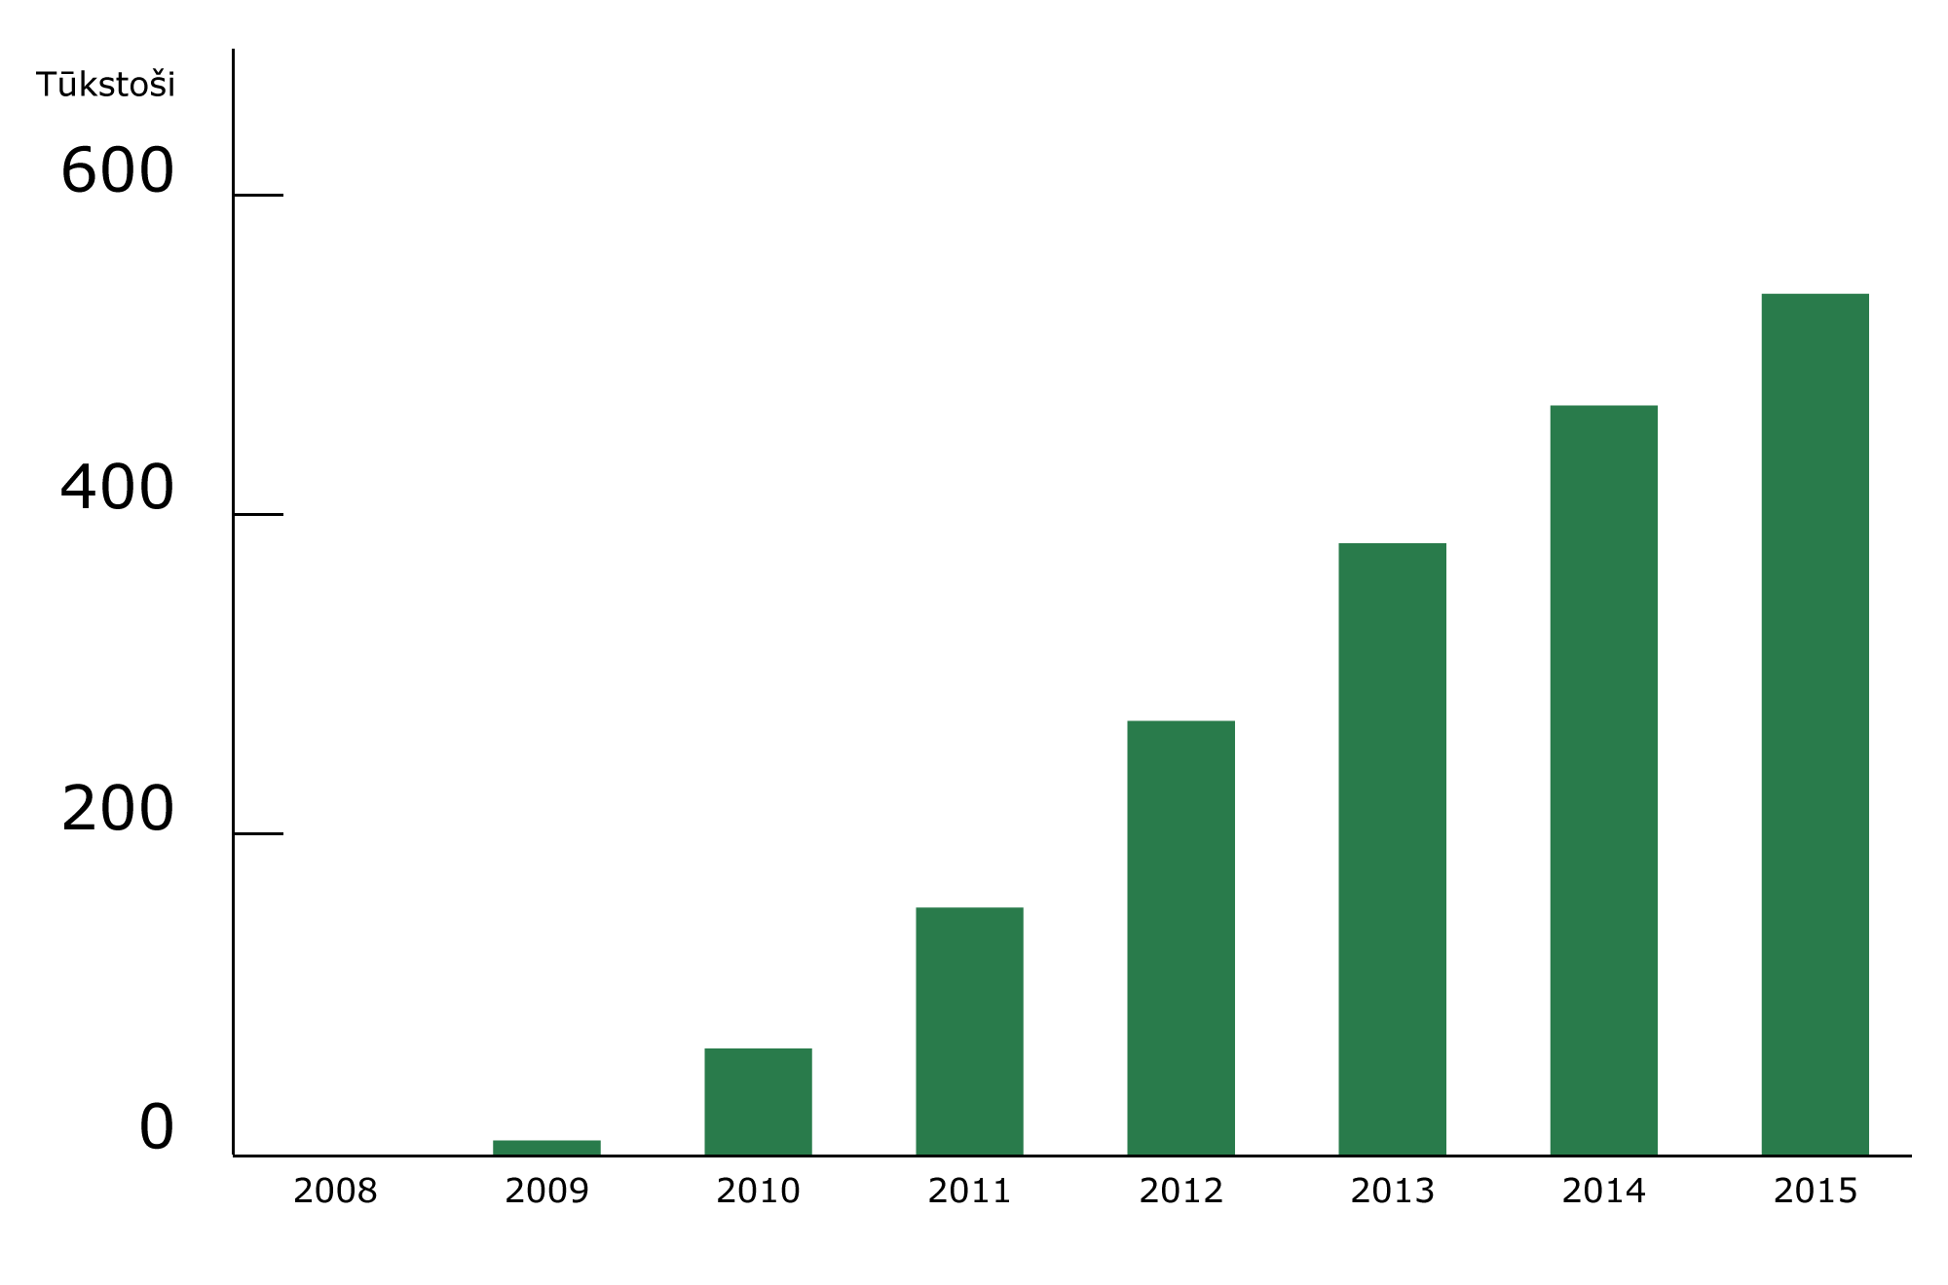
One in four inhabitants of Latvia has used
Thousand
Unique users of Latvija.lv who have started using e-services
Notes:
As we can see from the chart, the use of Latvija.lv e-services tends to increase — each year, the inhabitants of Latvia tend to use this site more frequently. From the point of view of an inhabitant, it is a centralised site of services, while from the point of view of an institution, it is a platform where current and potential clients gather in the Internet environment and can be easily reached.

Slide 8
How can the Public Service Directory be useful?
Notes:
As it has been mentioned in presentations, Latvija.lv features the Public Service Depository, the use of which requires only a computer, a tablet or other device with Internet connection.

Slide 9
The Public Service Directory: all state and local government services in a single place
You can search for a necessary service by:
name of the service;
institution;
real life situation.
Notes:
Everybody knows that state institutions provide many different services to both inhabitants and entrepreneurs. Institutions provide services according to the tasks and functions assigned thereto.
Since the number of institutions and services provided by them is great, in order for inhabitants and entrepreneurs to be able to orient in the assortment better, a single Public Service Depository has been created, providing an opportunity to find all the services provided by the state in a single place by:
- name of the service;
- institution;
- real life situation.

Slide 10
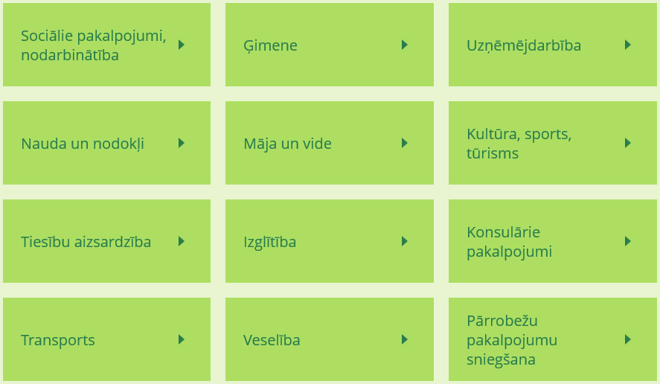
Services for any real life situation
Notes:
When you enter Latvija.lv, you see the Public Service Depository divided into the groups of different life topics.

Slide 11
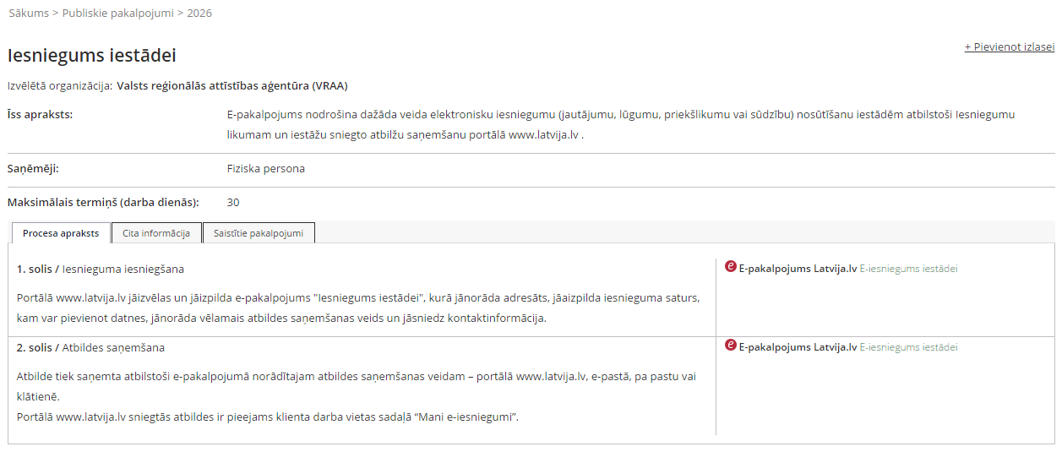
Example of a Public Service Publication card
Information on the service
Information on where and how to receive the service
Notes:
In the description, you can find out about where and how it is possible to receive the service.

Slide 12
What are the possibilities
of e-services on ?
Notes:
The second crucial part of Latvija.lv is the catalogue of e-services, where, as I have already mentioned, over 350 electronic services are available.

Slide 13
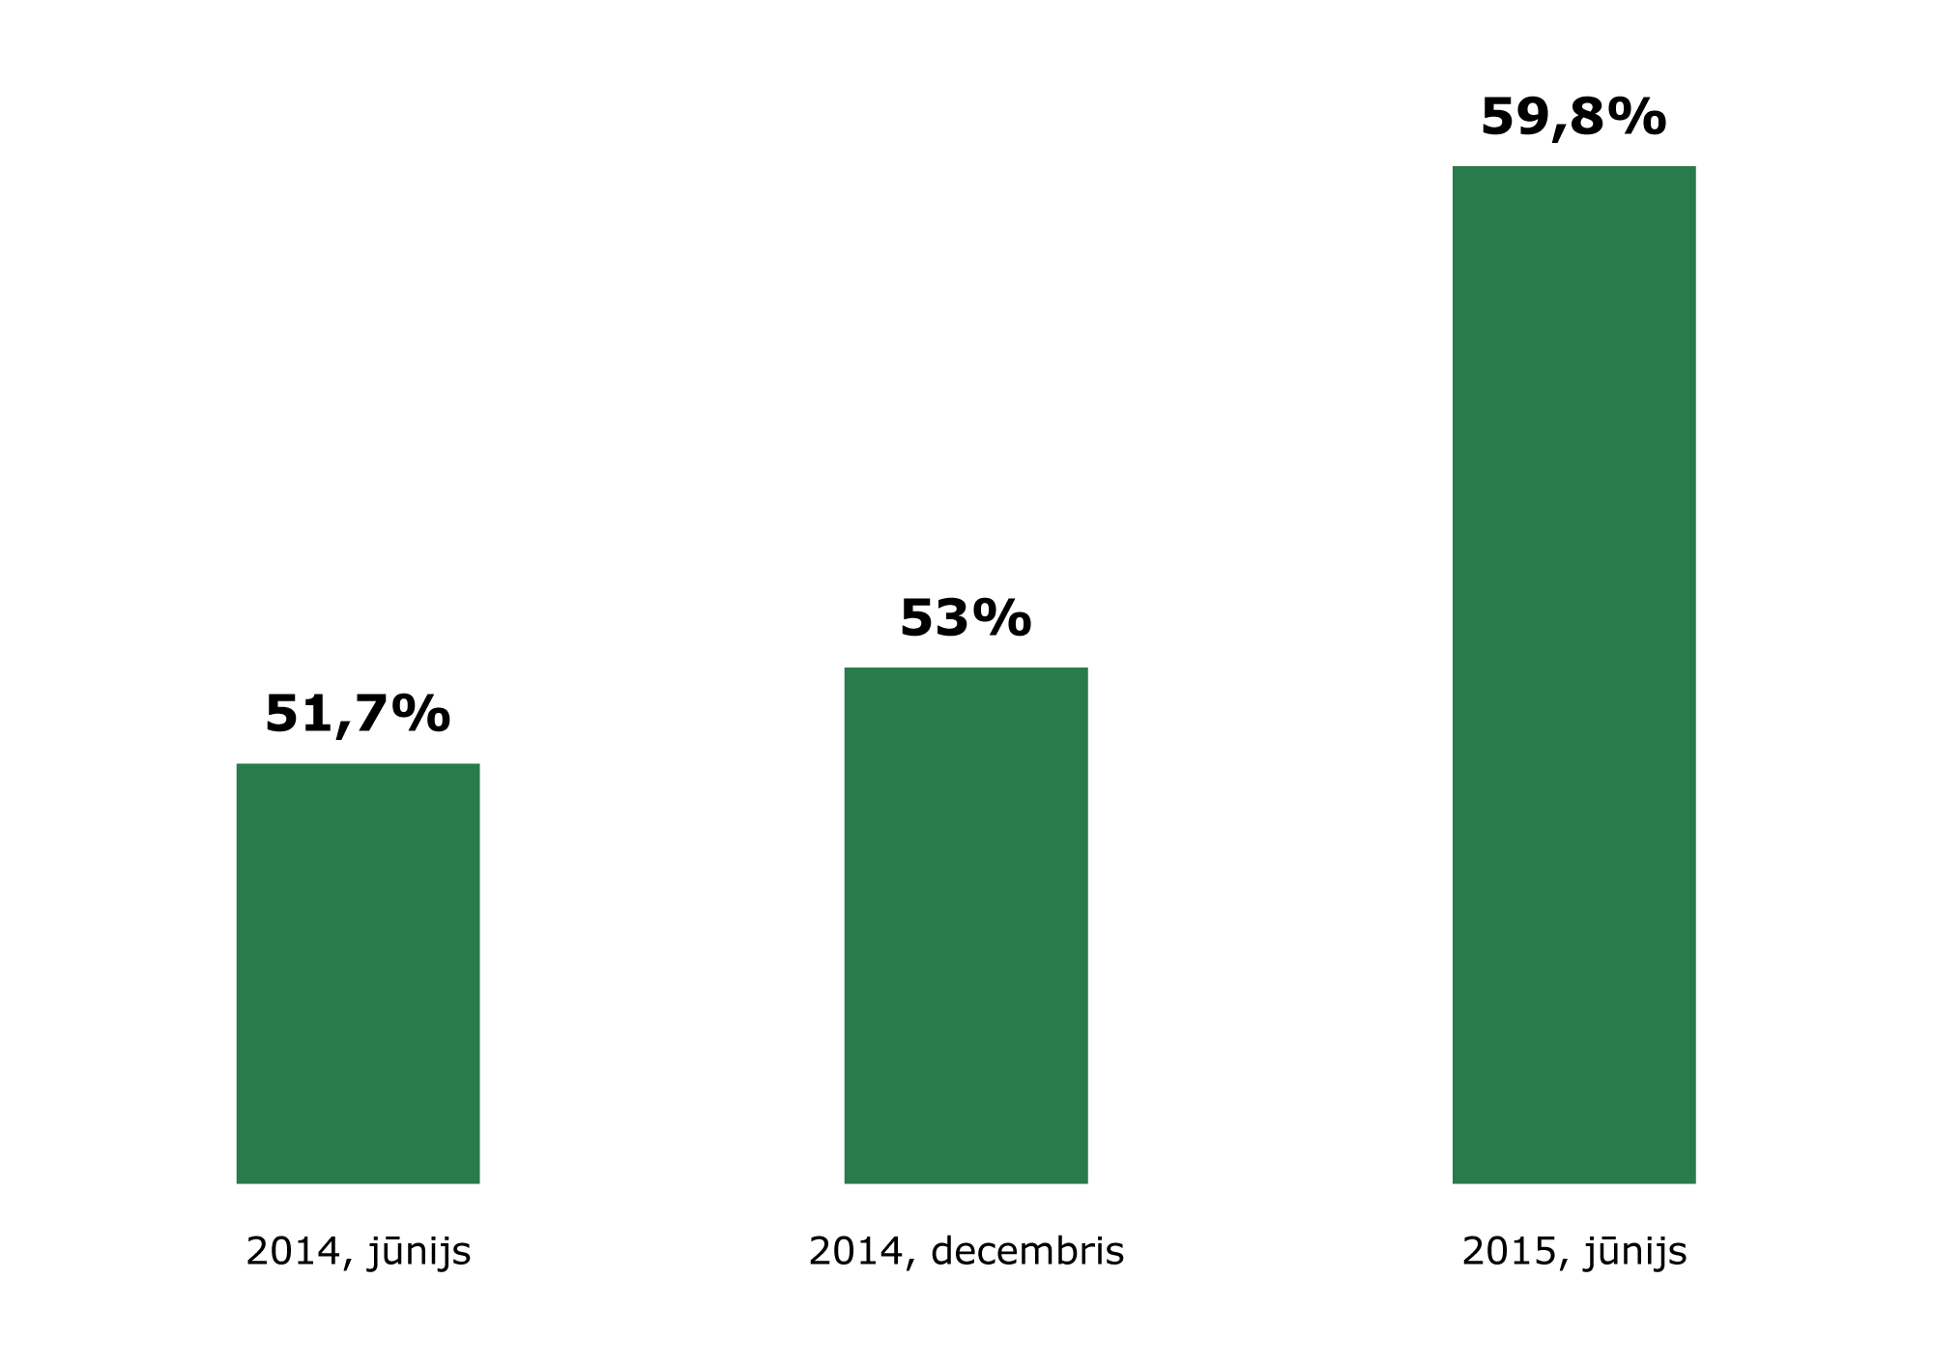
Inhabitants tend to use e-services more frequently
July 2014
December 2014
June 2015
Inhabitants who used e-services provided by the state and local governments over the last 6 months
MEPRD’s (Ministry of Environmental Protection and Regional Development) study of public opinion on the use of e-services in Latvia
Notes:
Inhabitants tend to use e-services more frequently — over the year, the number of e-service users has increased by 8%.

Slide 14
Most popular
e-services in 2015
Submission of the declaration of the place of residence
1.
Electronic application for studies within the framework of basic study programmes
2.
3.
My data in the Population Register
Information on the planned amount of old-age pension
4.
Bank account statement of the participant to the state-funded pension scheme (second pillar pension)
5.
Information on social insurance contributions and insurance periods
6.
Registration with registers maintained by the Register of Enterprises
7.
Notes:
These are the most popular e-services available on Latvija.lv this year:
as can be seen, the first place is taken by the universal service that can be and is used by wider public; moreover, this service has been the most popular since its creation (for six years);
other services are services of a narrower profile provided by a particular institution (OCMA, SSIA, RE).

Slide 15
Advantages of e-services
E-services: services provided by state and local government institutions via the Internet:
24/7 — at any time;
CONVENIENTLY — at any place;
SECURELY — with secure access and personal identification;
SIMPLY — it is possible to make a payment, if necessary.
Notes:
E-services allow the user to contact state and local government institutions at any time and place; moreover, they are secure and simple.

Slide 16
E-services save money
Costs of provision of a service
Provision of a service on Latvija.lv
Costs of provision > EUR 5.50
Institution’s time — 15 minutes
Person’s time — 1 hour
Costs of provision < EUR 1.40
Institution’s time — 0 minutes
Person’s time — 15 minutes
Notes:
Example of an e-service benefit — how it saves institution’s and client’s money.

Slide 17
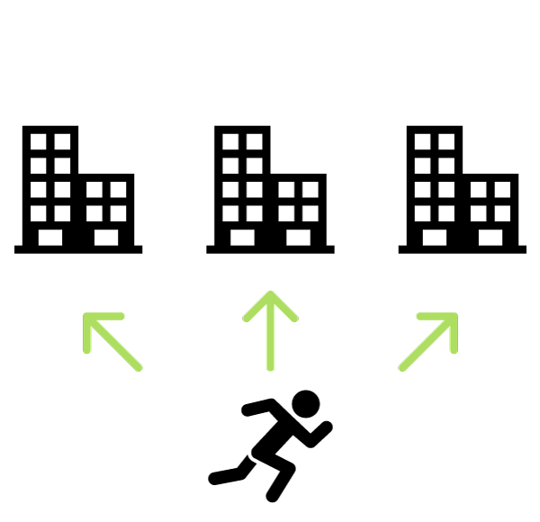
E-services save time
Before: entrepreneurs had to visit three institutions to submit statements for procurements
Now: institutions themselves receive information from registers without involving the entrepreneur
Benefit:
one entrepreneur saves one full working day of one employee, i.e., EUR 1 million a year for all enterprises together;
the savings of the state administration amount to 14 work loads, which would be spent on the issue of statements.
Notes:
Example of an e-service benefit — how it saves institution’s and client’s time.

Slide 18
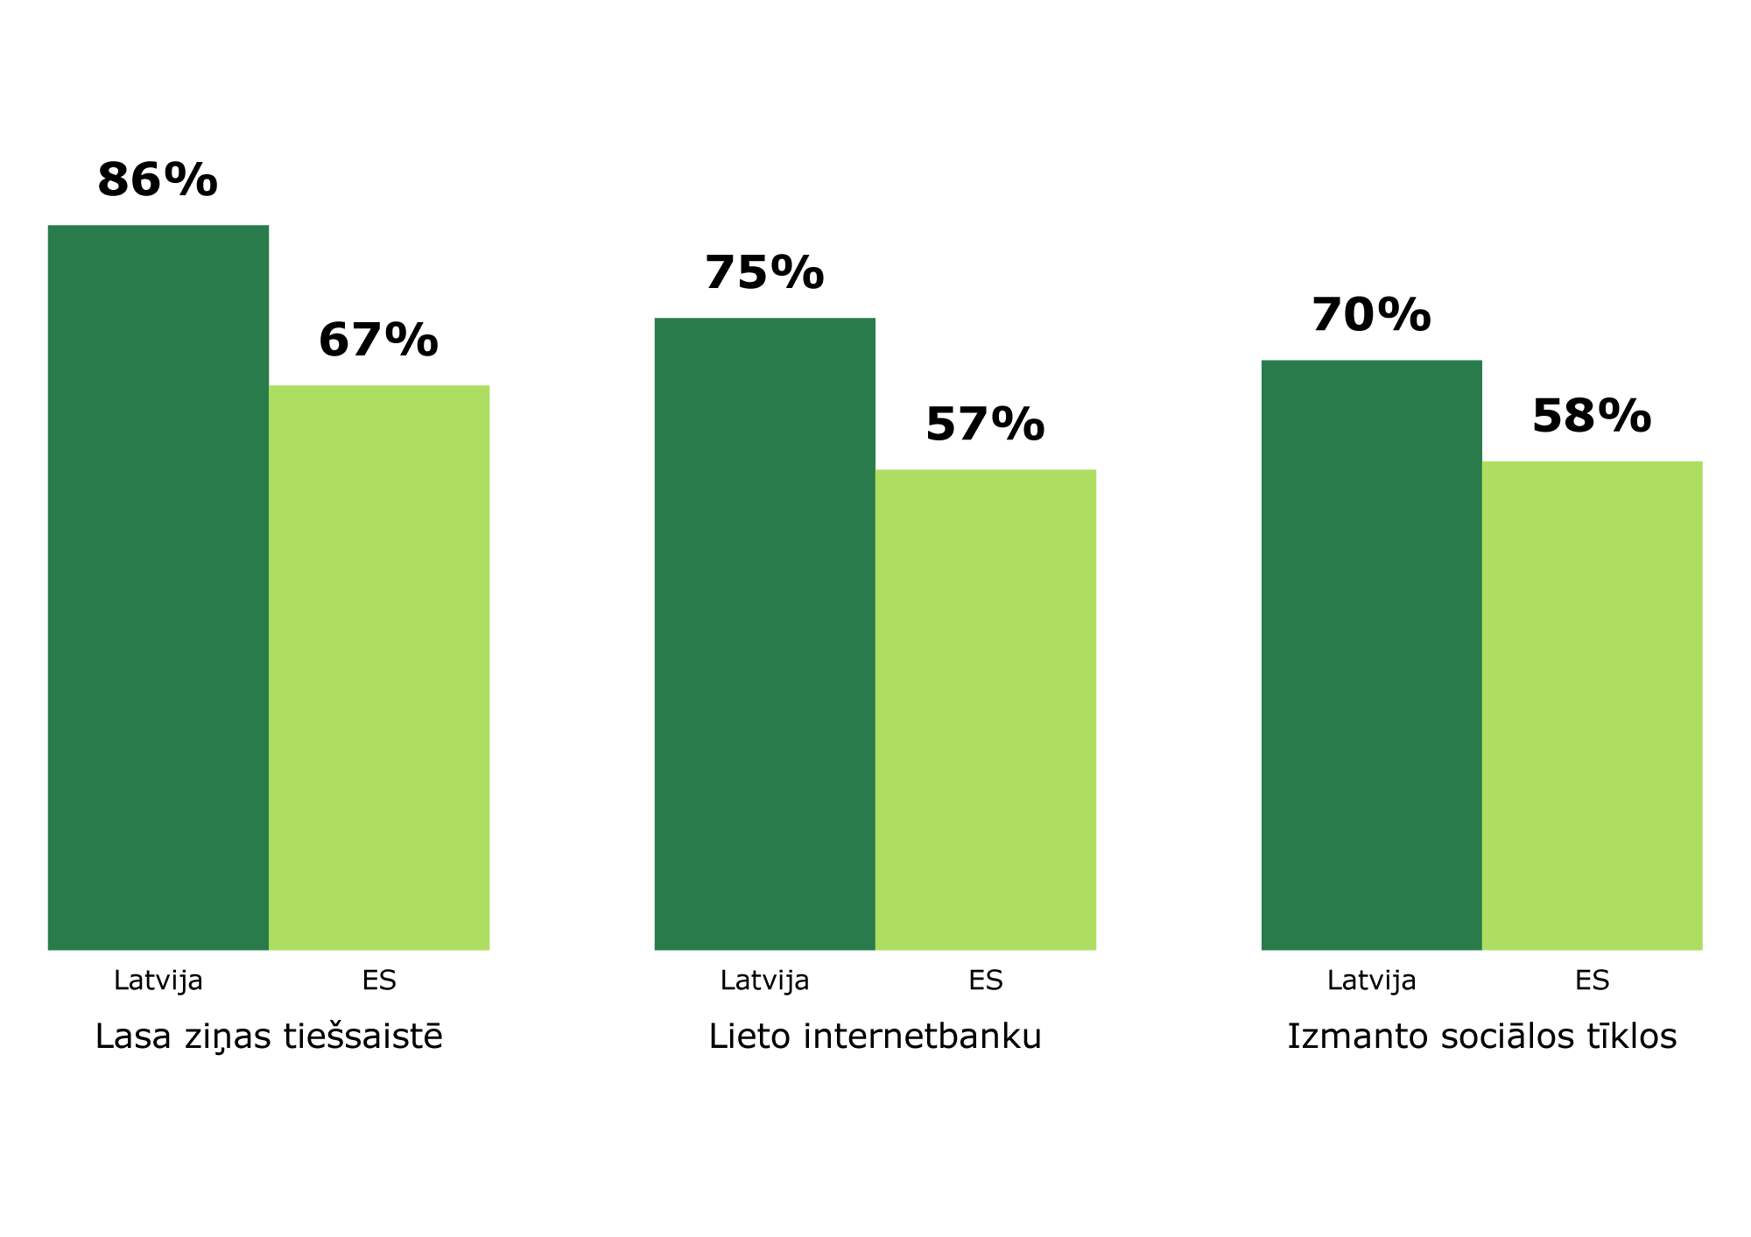
Inhabitants of Latvia are ready for communication with the state on the Internet
Latvia EU
Latvia EU
Latvia EU
Read news on-line
Use Internet banking
Use social networks
72% use the Internet on a regular basis (on average 75% in EU)
25% use state e-services (on average 33% in the EU)
90% of e-service users admit that these services have facilitated their everyday life
MEPRD, EC Digital Economy and Society Index 2015
Notes:
Inhabitants of Latvia are ready for communication with the state on the Internet — just as we read news on-line, use Internet banking systems and social networks (moreover, more than on average in EU) in everyday life, we have all the preconditions for the active use of e-services.

Slide 19
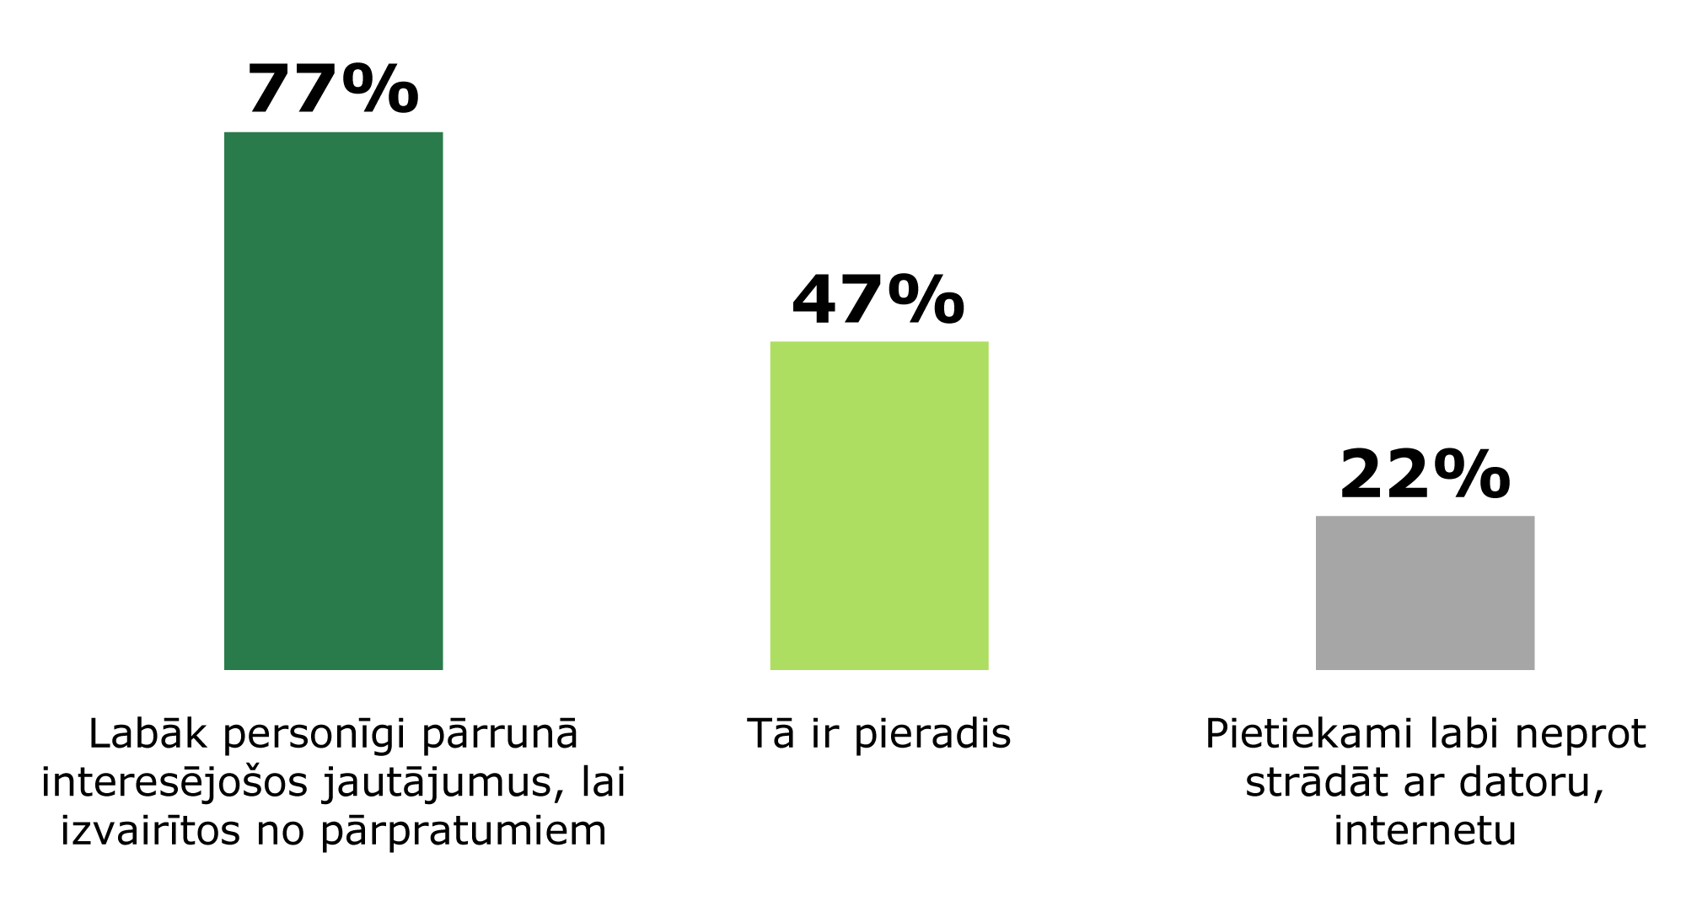
Mastering of e-services is delayed only by the fear to make a mistake and by the habit
Better discuss the questions of concern in person to avoid misunderstandings
It is a habit
No sufficient understanding of the work with a computer, Internet
Why should we not choose to use services provided by the state and local governments electronically?
MEPRD’s (Ministry of Environmental Protection and Regional Development) study of public opinion on the use of e-services in Latvia
Notes:
Mastering of e-services is delayed only by the fear to make a mistake and by the habit; moreover, computer skills are often doubted.

Slide 20
How to use ?
Notes:
Now we will discuss practical information on how to use the portal and prepare your computer for work with an eID card and e-signature.
First, we will start with how to find the thing you are interested in on the portal.

Slide 21
How do you find the thing you are interested in on the portal Latvija.lv?
Catalogue of
e-services
Search by key words
Public Service
Directory
Notes:
This is the layout of catalogues on the home page of the portal:
the catalogue of e-services;
the Public Service Directory;
as well as a search window.
Moreover, in October 2015, Latvija.lv was improved for the site to become more convenient and clear (http://www.vraa.gov.lv/lv/news/article.php?id=41160 ).

Slide 22
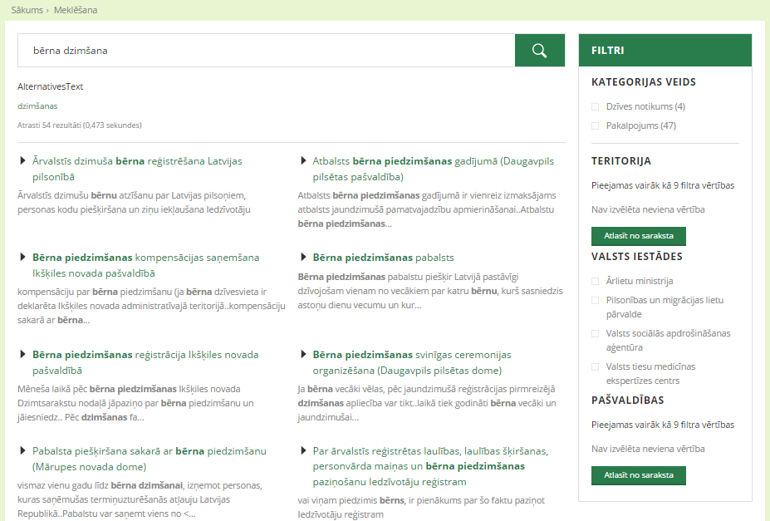
Search engine
Filters for the more detailed sorting of results, for instance, by territory, institution, etc.
Found
results
Notes:
To find information quickly, it is recommended using the search engine by entering the key words of interest. Search results reflect the following:
found results;
search duration;
filters for the more detailed sorting of results, for instance, by territory, institution, real life situation, etc.
Moreover, along with improvements introduced in October 2015, the search and translation of information on the portal has become more convenient. Search tools used to be divided: the Public Service Directory used one tool, the catalogue of e-services — another; now, they are combined into one.

Slide 23
Recognise the type of a service
On the portal, e-services can be recognised by two types of “ē!” symbols next to the name:
e-services available on the portal Latvija.lv
e-services located on some other website
Notes:
On the portal, e-services can be recognised by two types of “ē!” symbols next to the name:
the red symbol means e-services placed on the portal Latvija.lv (for instance, E-application to an institution, Payment of immovable property tax, and over 100 other e-services);
the blue symbol means e-services located on some other website (for instance, SRS EDS, RTSD, e.sigulda.lv and over 160 other e-services).

Slide 24
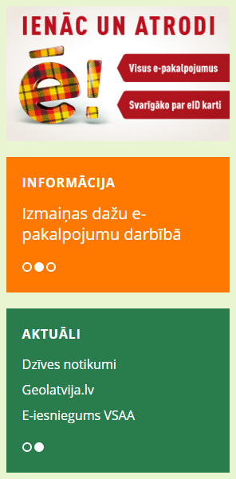
E-services for all real life situations
Notes:
The “Real life events” section is located on the left side of the start page of the portal Latvija.lv; here, it is possible to find out more about different services and the receipt thereof according to the list of real life events.

Slide 25
What is necessary to start using
?
Public Service
Directory:
E-services:
or
Computer, tablet or smartphone with Internet connection
Internet banking
eID card and e-signature
Notes:
A computer, a tablet or other device with internet connection is the only thing necessary to start using the Public Service Directory.
There are two ways of authentication for using e-services:
via the Internet banking systems of seven banks, where no additional preparation is required;
whereas to apply by means of electronic identification, i.e. an eID card or electronic signature smart card authentication, one-time preparatory works are required.

Slide 26
How to use e-services?
1.
Choose an e-service (in the catalogue or by using the search engine)
Authenticate yourself
with an eID card and e-signature
or via any Internet banking system
2.
3.
Carry out the execution of an e-service
4.
If necessary, make payment
5.
Receive the service immediately or later (moreover, they can be in the form of both document and template)
6.
Finish your work or return to the “My working place” section to view latest news on your e-services.
Notes:
E-services differ — some of them are databases publicly available for everyone, others requires authentication; however, in most of the cases, they include the steps shown in this slide.

Slide 27
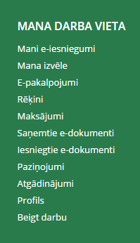
My working place: all your activities on the portal
Notes:
The working place on the portal Latvia.lv features the summary of user’s activities.

Slide 28
Authentication
Notes:
Second — how is it possible to authenticate yourself for using e-services.

Slide 29
How to authenticate yourself for using e-services?
Choose the most convenient method of authentication
(In certain cases only, it is impossible to choose; for instance, the signature collection e-service requires an e-signature)
Via the Internet banking system
With an eID card or an e-signature
No additional preparation is required.
One-time preparatory works are required.
Notes:
There are two ways of authentication for using e-services:
via the Internet banking systems of seven banks, where no additional preparation is required;
whereas to apply by means of electronic identification, i.e. an eID card or electronic signature smart card authentication, one-time preparatory works are required.

Slide 30
How to prepare for the use of
with an eID card and e-signature?
Notes:
Third, how to prepare your computer for work with an eID card and e-signature.

Slide 31
What is necessary to start the work?
Computer
eID card
Smart card reader
Computer with Internet connection
eID card is issued by the OCMA
Request an e-signature!
You can purchase a card reader at an appliance store
When in library, do not hesitate to ask the librarian for an advice on the use of e-services!
T: 8300
E: eID@pmlp.gov.lv
W: www.pmlp.gov.lv
Correspondence with places of trade is available on www.eparaksts.lv in the “eID card” section.
Notes:
A computer, an eID card and a smart card reader are necessary.
If you have decided to use an e-service, the receipt of which requires authentication or signing with a secure electronic signature, make a use of your eID card. Remember, an eID card features 120 e-signatures without extra charge. Moreover, if you already own an eID card, yet there are no e-signatures in it, you can activate them for free for the already issued card.

Slide 32
Computer prepared for work with an eID card and e-signature
Follow the instructions on eparaksts.lv in the “eID card” section
1
Install signing/verification software eParakstītājs 3.0
2
Make sure that an e-signature is active and valid
3
Prepare your Internet browser for work with an eID card
T: 67018989 E: eparaksts@eparaksts.lv W: www.eparaksts.lv
Notes:
Follow the instructions on eparaksts.lv in the “eID card” section and prepare your computer for work with an eID card and e-signature.

Slide 33
How to make sure that an e-signature is active and valid?
1
Place your card in the reader
2
Open eParakstītājs 3.0
3
Click Rīki (Tools) → Sertifikāti (Certificates) (information will be shown in the window)
Attention!
An e-signature is activated within 24 hours after receiving the card.
Also, in the event a new PIN envelope is prepared at the OCMA division, 24 hours must elapse before an e-signature becomes active.
Notes:
If you wish to check, whether an e-signature is active and valid, follow these three steps.
Remember, an eID card features 120 e-signatures without extra charge. Moreover, if you already own an eID card, yet there are no e-signatures in it, you can activate them for free for the already issued card.

Slide 34
Make sure you are ready!
Your computer has Internet connection
You have a smart card reader
Your computer is ready for work with an e-signature and eID card
Your eID card has active e-signing certificates and you remember your PIN codes
Your Internet browser is ready for work with an eID card
Notes:
When all preparatory works have been fulfilled, you just have to check if everything necessary has been done.

Slide 35
We will help you!
Preparation of the computer may take time and patience; however, it must be carried out once only, and you can always ask us for advice!
Should any questions regarding the execution of an e-service on Latvija.lv arise, contact the portal user support service:
T: 67502757
E: portals@vraa.gov.lv
If you cannot authenticate yourself or sign with an e-signature on the portal Latvija.lv, contact the support service:
T: 67018989
E: eparaksts@eparaksts.lv
Notes:
Preparation of the computer may take time and patience; however, it must be carried out once only, and you can always ask us for advice!

Slide 36
Find out more:
List of e-services on Latvija.lv: https://www.latvija.lv/lv/Epakalpojumi
Infographic “Enter Latvija.lv using an eID card”: https://www.latvija.lv/lv/Aktualitates/2015/EID
Follow the news on e-services in social networks as well:
Twitter — twitter.com/PortalsLV
Facebook — www.facebook.com/latvija.lv
Draugiem.lv — www.draugiem.lv/latvija
Notes:
Additional information is available on specified sites.

Slide 37
Remember!
Before visiting an institution in person, check if a service is available on the Internet!
Should any doubts or uncertainty arise, do not be afraid to ask for an advice!
Portal user support service:
telephone: 67502757.
e-mail: agnese.berzina@vidzeme.vp.gov.lv
Consultation hours:
Monday – Friday
08:30–16:30
Notes:
We remind you:
before visiting an institution in person, check if a service is available on the Internet;
should any doubts or uncertainty arise, do not be afraid to ask for an advice!

Slide 38
For inhabitants and entrepreneurs
What is ?
Notes:
Thank you! Questions?

